Slide 1

PHISHING WEBSITE DETECTION USING NLP AND ML
School of Computer Science and Engineering
Department of Computer Science and Engineering
Submitted By:
VARDAAN THAKUR
2427030052
Supervised By:
Dr. Usha Jain

Slide 2
Outline
Introduction
Literature Review
Problem Statement
Proposed Methodology
Objectives
References

Slide 3
Introduction
The Internet is now essential for business, government, and social interactions, driven by hyper-connectivity and mobility.
With this increased dependence, the risk of cyber attacks has also grown.
Automating the extraction of cyber threat information enables faster detection and response to new or evolving threats.

Slide 4
Introduction (Contd.)
This project focuses on automating the identification of emerging cyber threats using Natural Language Processing (NLP) and Machine Learning (ML).
Machine Learning (ML) algorithms recognize phishing sites by identifying complex patterns in large datasets of website attributes and URLs.​
Natural Language Processing (NLP) analyzes textual and semantic features from webpage content and URLs, uncovering subtle anomalies overlooked by standard methods

Slide 5
Literature Review
Data Sources: OpenPhish, PhishTank, Anti-Phishing Working Group datasets (phishing samples), Kaggle Phishing Website Dataset, OSINT (Twitter).
Need for automation
The volume and velocity of OSINT make manual monitoring infeasible. Automation (NLP + ML) is required to extract timely, actionable alerts.
Role of NLP in Cybersecurity
NLP helps interpret unstructured text from tweets and reports to detect entities, threat names, and relationships between attack elements.

Slide 6
Literature Review (Contd.)
Key gaps in prior work
Many systems detect possible threat events but don’t name or profile the threat
Limited systems map identified threats to MITRE ATT&CK tactics for understanding attacker behavior.
Contribution of This Work
Proposes an automated NLP-ML pipeline for detecting and profiling emerging cyber threats.
Uses One-Class Classification to filter irrelevant tweets and Multi-Class Classification to map threats to MITRE ATT&CK tactics.
Employs TF-IDF, NER, and normalization techniques for accurate threat name identification.
Generates timely alerts enriched with risk assessment for cybersecurity engineers

Slide 7
Problem Statement
Traditional phishing website detection methods, such as maintaining blacklists or manually verifying websites, are slow and ineffective against newly created phishing sites.
Need for an intelligent system that can automatically detect phishing websites by analyzing their content and structure by using Natural Language Processing (NLP) and Machine Learning (ML)

Slide 8
Objectives
To improve the accuracy and speed of phishing detection compared to traditional methods.
Adaptation to Evolving Attacks : To create an adaptive and dynamic defense system that can learn and recognize the ever-changing patterns of sophisticated phishing techniques
To help users stay safe online by warning them about potentially harmful websites

Slide 9
Proposed Methodology
The proposed framework automatically identifies emerging cyber threats by analyzing data from social media using NLP and ML.
Approach Overview:
Continuous Monitoring :Collect cybersecurity-related tweets from verified experts and companies.
NLP + ML Processing :Use NLP to extract terms and ML to classify potential threats.
MITRE ATT&CK Mapping : Match identified threats to MITRE ATT&CK tactics.
Alert Generation :Create alerts for newly emerging or evolving threats, with risk ratings.
Outcome:
Automated, real-time system that assists cybersecurity engineers in early detection and response.

Slide 10
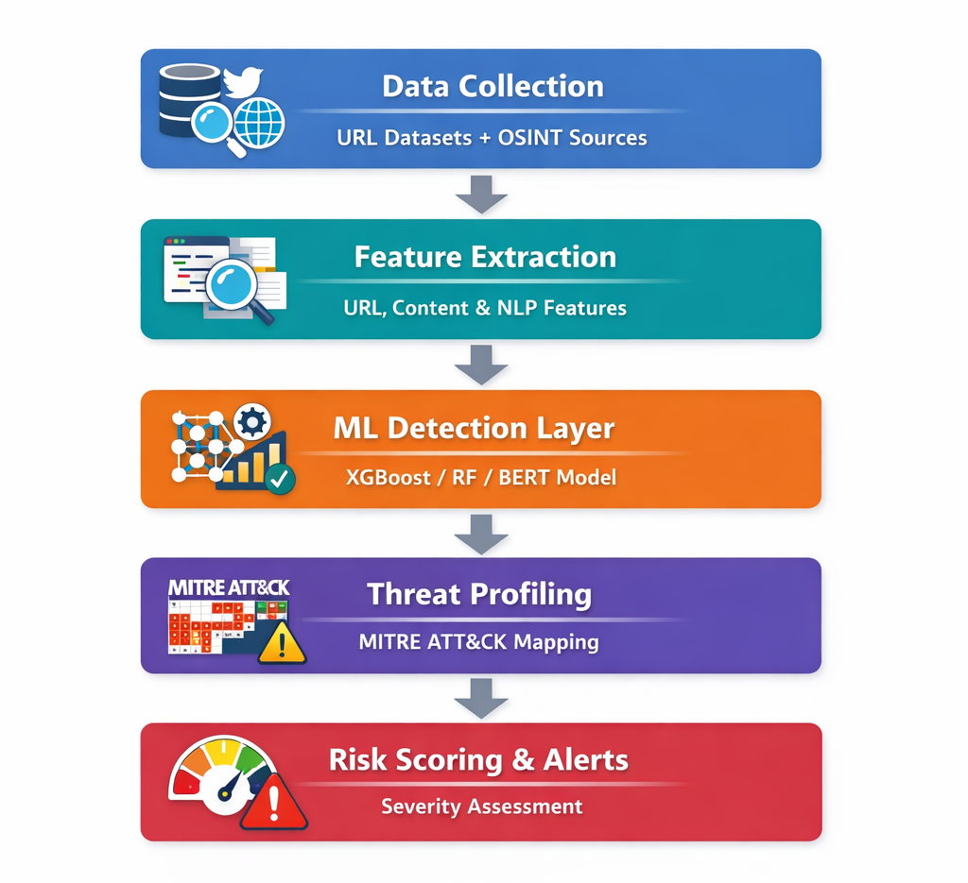
Proposed
Methodology

Slide 11
Proposed Methodology (Contd.)
1. Data Collection Layer
The system collects data from:
Public phishing datasets (Kaggle, UCI, PhishTank, OpenPhish)
Real-time OSINT sources (Twitter, security blogs)
Webpage scraping mechanisms
This ensures coverage of both historical phishing data and emerging threats.
2. Feature Extraction
URL-Based Features
Webpage Content Features
NLP-Based Text Features

Slide 12
Proposed Methodology (Contd.)
3. Machine Learning Detection Layer
The core detection engine uses:
XGBoost (Primary Model)
High accuracy
Handles imbalanced datasets
Strong performance on structured features
Random Forest (Secondary Model)
Used for comparison and ensemble learning
BERT Model
Used for analyzing webpage content and social media posts

Slide 13
Proposed Methodology (Contd.)
4. Threat Profiling (MITRE ATT&CK Mapping)
Once a website is classified as phishing, the system profiles it according to MITRE ATT&CK tactics:
This provides contextual intelligence instead of just a binary decision.
Phishing Behavior | Mapped Tactic
Fake login page | Credential Access
Email phishing campaign | Initial Access
Data harvesting | Exfiltration
Redirection attack | Defense Evasion

Slide 14
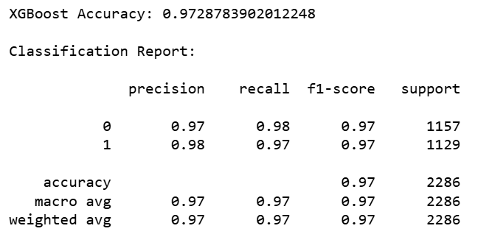
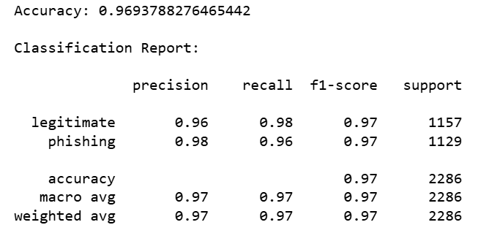
Result
XGBoost
Random Forest

Slide 15
Outcome
The project successfully demonstrates that machine learning techniques, particularly XGBoost, can effectively detect phishing websites with high accuracy (approximately 98–99%). The system provides a scalable and practical solution for early detection of malicious websites and contributes toward improving cybersecurity defenses.
1.Dataset Preparation & Preprocessing
Collected and analyzed a phishing website dataset containing 80+ engineered features.
Cleaned and preprocessed data by removing irrelevant fields (e.g., URL text column).
Encoded categorical labels (“legitimate”, “phishing”) into numerical format for model training.
2.Model Development
Implemented and trained multiple machine learning models:
Random Forest Classifier
XGBoost Classifier
Performed train-test splitting and model evaluation using standard metrics.

Slide 16
Outcome
3.Performance Evaluation
Achieved high classification accuracy:
Random Forest: 97–98%
XGBoost: 97–98%
Evaluated models using:
Accuracy
Precision
Recall
F1-Score

Slide 17
References
Marinho, R., & Holanda, R. (2023). Automated emerging cyber threat identification and profiling based on natural language processing. IEEE Access
Silvestri, S. et al. (2023). A Machine Learning Approach for the NLP-Based Analysis of Cyber Threats and Vulnerabilities of the Healthcare Ecosystem. Sensors, 23(3), 1225.
Sahingoz, O. K., Buber, E., Demir, O., & Diri, B. (2019). Machine learning based phishing detection from URLs. Expert Systems with Applications, 117, 345–357.
OpenPhish. (2024). OpenPhish Phishing Intelligence Feed.
PhishTank. (2024). PhishTank—Collaborative clearing house for phishing data

Slide 18
Thank You

